Slide 1

Casrak (A Smart way of saving)
All in one solution for Invest, Saving, financial budget plan, track expenditure & financial need and suggestion
Team : Segman Tech
Ajay Chaurasia
Sourabh Paswan
Pawan Kumar

Slide 2
Investment
Problem :
A normal person feels difficult to make investment plan due to their busy schedule.
Solution :
So we have come up with the solution where the App itself will provide you the best investment plans according to insights about users spend money while considering Low Risk, No Risk or High Risk.

Slide 3
Saving
Problem :
It’s hard to save for a normal person on daily basis.
Solution :
So we have come up with the solution where the App have a feature called Gullak with educating based habit to save on daily basis as small as any amount. User can make as many gullak according to their plan and needs.

Slide 4
financial budget plan, track expenditure & financial need and suggestion
Problem :
It feels more technical tantrum and boring to make a good budget plans.
Solution :
As a solution we are providing a better approach to user by guiding them by their spending behaviour and future goals and plans by correct inflation circumstances.

Slide 5
Technical solution approach
Azure Active directory
API Management
Redis
Azure policies for better scaling
Azure ML Studio for AI Analytics
RDBMS - Azure SQL
NoSQL - Azure Cosmos
JHipster and ISAC
Docker/Kubernetes
Java/Spring Boot and Kafka

Slide 6
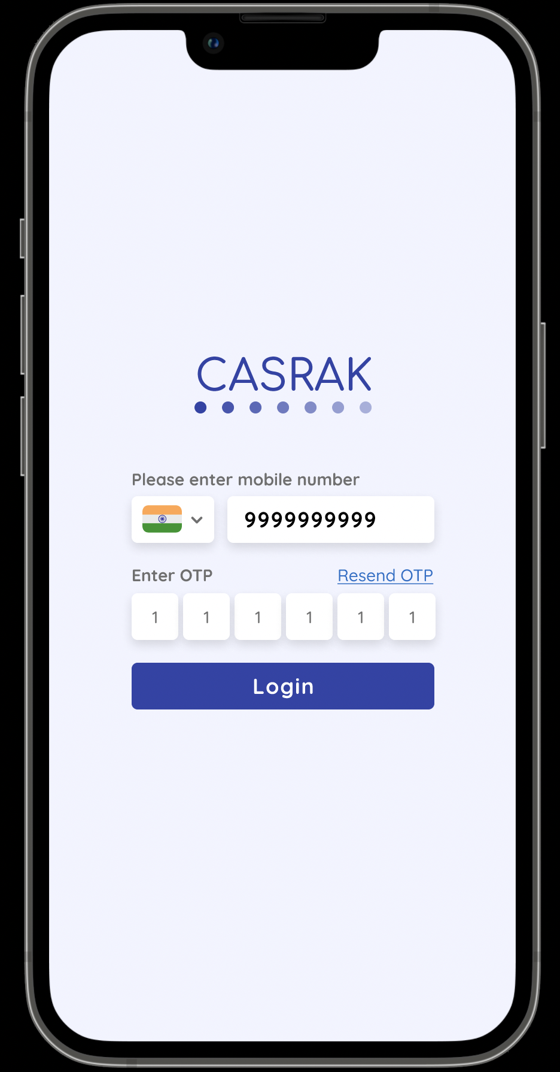
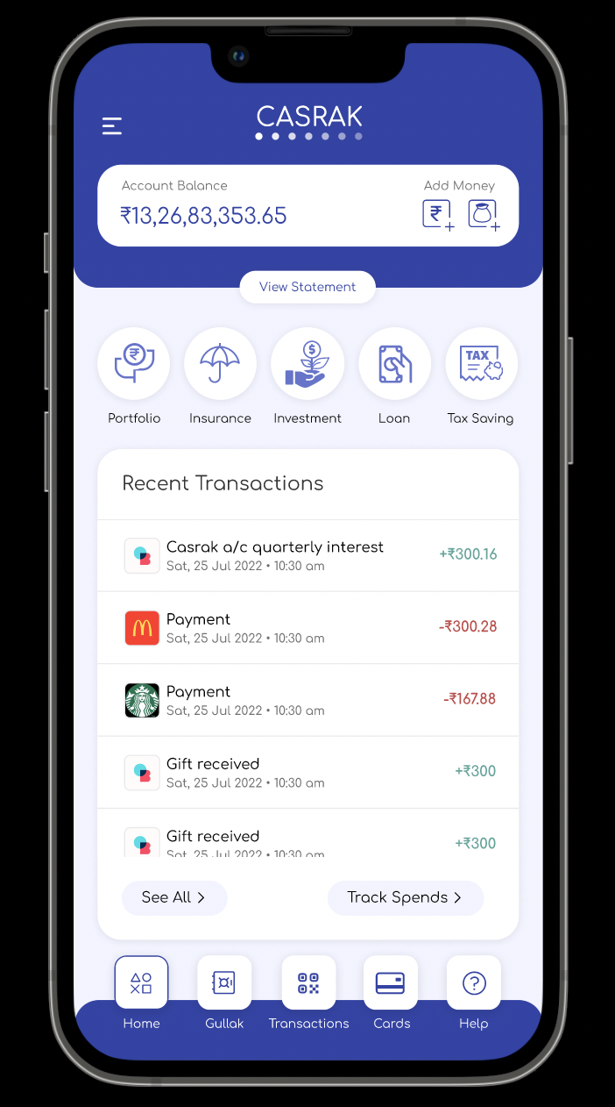
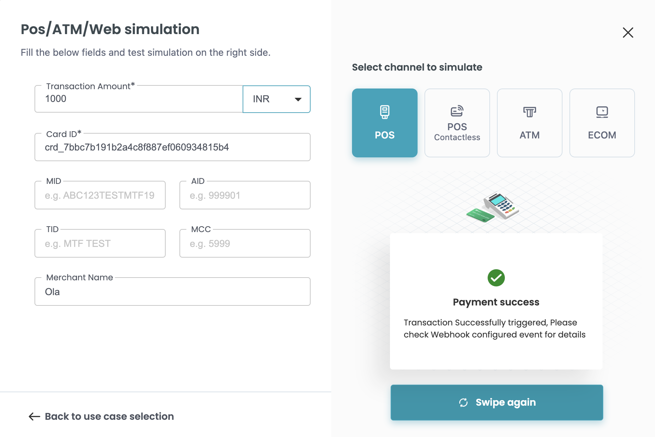
Sample Screens

Slide 7
Thank You

